Slide 1
Voting Accessibility Advisory Committee (VAAC)
A forum for representatives of the disability and senior communities to have open discussions about any challenges they face while voting.

Slide 2
Agenda
Elections Staff/Attendee Introductions
Committee Role
Presentations:
VCA/Draft Election Administration Plan (EAP)
Selected locations for Placer County vote centers and drop boxes
Factors in choosing the vote centers
HAVA diagram packet with larger mitigations for discussion
Discussion on Mitigations / Questions & Answers
Future Agenda Items
Notes:
Introductions
Role of a committee member (input) and time commitment (yearly) – meeting quarterly / twice a year ?

Slide 3
Election Administration Plan
Voters Choice Act
Draft Plan
Vote Centers
Drop Boxes
Public Input
Voter Contact(s)
Language Minority Communities
Voters with Disabilities

Slide 4
Vote Center Locations
11-day locations
Placer County Elections Office – Auburn
Placer County Elections Office – Rocklin
Lincoln Veterans Hall
Martha Riley Library
Roseville Veterans Hall
Granite Bay Library
The Old Firehouse – Tahoe City (potential)
Notes:
A handout of the proposed vote centers and a list of drop boxes were handed out at the start of the meeting for your review.

Slide 5
Vote Center Locations
4-day locations
North Tahoe Event Center
Alta Community Center
Colfax Veterans Hall
Foresthill Veterans Hall
Meadow Vista Community Center
Auburn Veterans Hall
Loomis Veterans Hall
Lincoln Library
Sun City Lincoln Hills
Whitney High School
Sierra College
Cooley Middle School
Rocklin High School
West Park Middle School
Mike Shelito Indoor Pool
Chilton Middle School
Maidu Community Center
Roseville Church of Christ
@ the Grounds
Granite Bay High School
Buljan Middle School
Springview Middle School
Notes:
A handout of the proposed vote centers and a list of drop boxes were handed out at the start of the meeting for your review.

Slide 6
Drop Box Locations
Placer County Elections Office – Rocklin
Rocklin Library
Rocklin City Clerk’s Office
Sierra College (potential)
Destiny Community Center
Whitney Ranch (potential)
Veterans Services Office
Sun City Lincoln
Lincoln City Clerk’s Office
Granite Bay Library
Loomis Town Clerk’s Office
Nugget Market (Pleasant Grove)
Santucci Justice Center
Nugget Market (Blue Oaks)
Martha Riley Library
Roseville City Clerk’s Office
Roseville Downtown Library
Maidu Library
Veterans Memorial Hall
Colfax City Clerks’ Office
Colfax Library
Kings Beach Library
The Old Firehouse (potential)
Auburn City Clerk’s Office
Olympic Valley Public Service (potential)
Placer County Elections Office – Auburn
Notes:
A handout of the proposed vote centers and a list of drop boxes were handed out at the start of the meeting for your review.

Slide 7
11-day vote centers
Notes:
11-Day Vote Centers: ​
​
Starting on the Saturday two weekends before the election, 11-day vote centers become available throughout Placer County. These centers give the public the opportunity to register to vote, obtain a replacement ballot, submit their voted ballot, or vote in person.

Slide 8
11-day vote centers
4-day vote centers
Notes:
4 Day Vote Centers:​
​
On the Saturday four days prior to the election, more locations will be included across the county to offer convenient options to voters and citizens as demand increased.

Slide 9
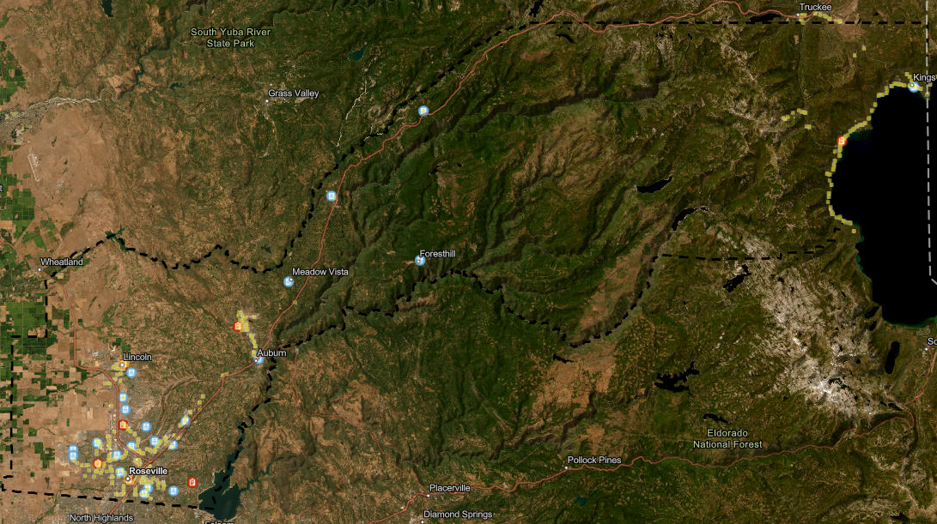
Public transit
Notes:
To allow transit riders the shortest walk to a vote center location the site should be as close to public transit as possible,
The majority of the proposed locations are within 200 feet of a designated bus stop.

Slide 10
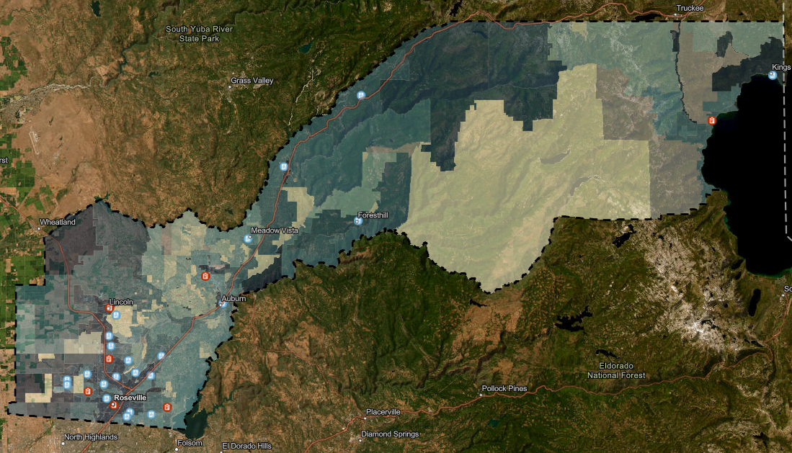
Low mail ballot utilization
Notes:
When determining vote center locations, priority should be given to areas with low mail ballot utilization, specifically those with darker colors. Mail ballot utilization refers to the percentage of eligible voters who had the option to vote by mail but chose not to. Locations with lower percentages of mail ballot utilization may indicate that voters prefer to vote in-person.

Slide 11
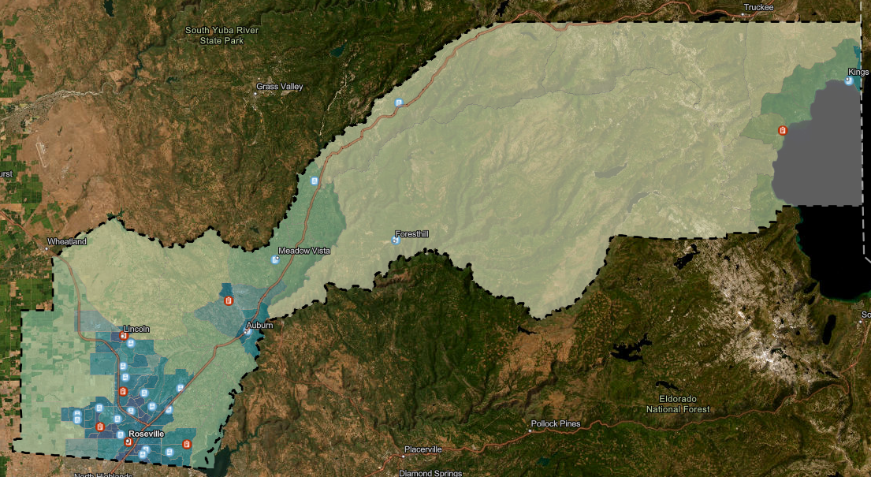
High-density population
Notes:
To maximize accessibility, vote centers should be placed in or near densely populated areas marked by darker colors on maps.
Strategic placement ensures that the largest number of citizens and voters have easy access to voting, with minimal travel time required.

Slide 12
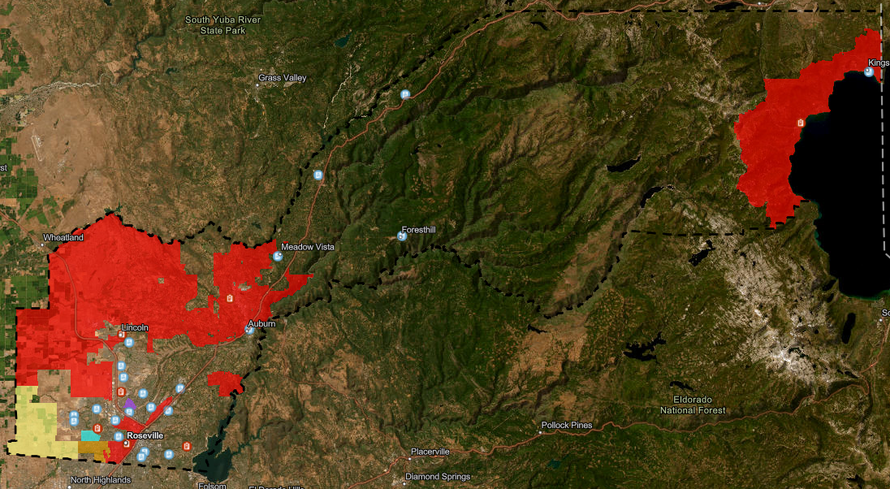
Language minority communities
Notes:
Language minority communities is an important consideration when deciding on the locations of vote centers.
In Placer County, there are four additional languages besides English, with Spanish being the only one prevalent across most of the county, marked in red on the map.
Korean (purple), Punjabi (blue), and Tagalog (yellow) are used in some communities in southwest Placer. Orange indicates areas where Spanish and Tagalog are spoken together.
Placer County is required by state and federal law to offer certain services and materials in these additional languages at vote centers located in or adjacent to these communities, including providing translators.

Slide 13
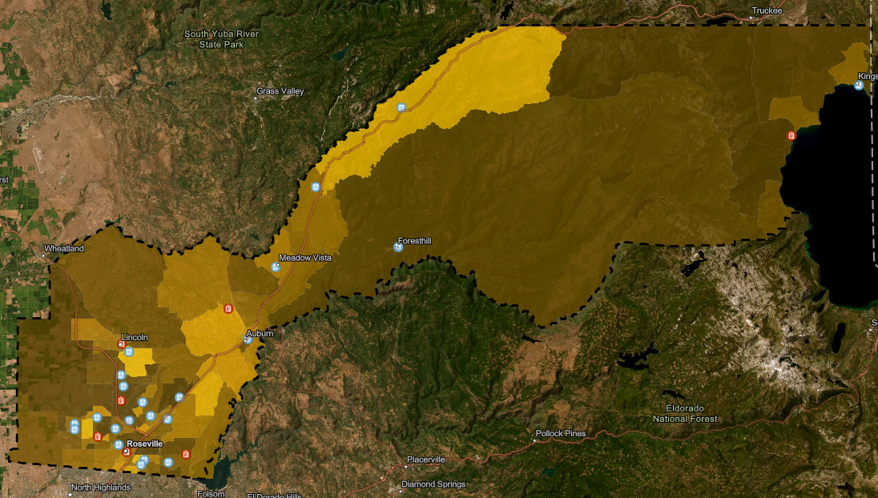
Higher rates of disabilities
Notes:
Vote centers are designed to assist voters with disabilities. By placing them near communities with higher rates (highlighted in bright yellow), these voters can easily access the services offered.

Slide 14
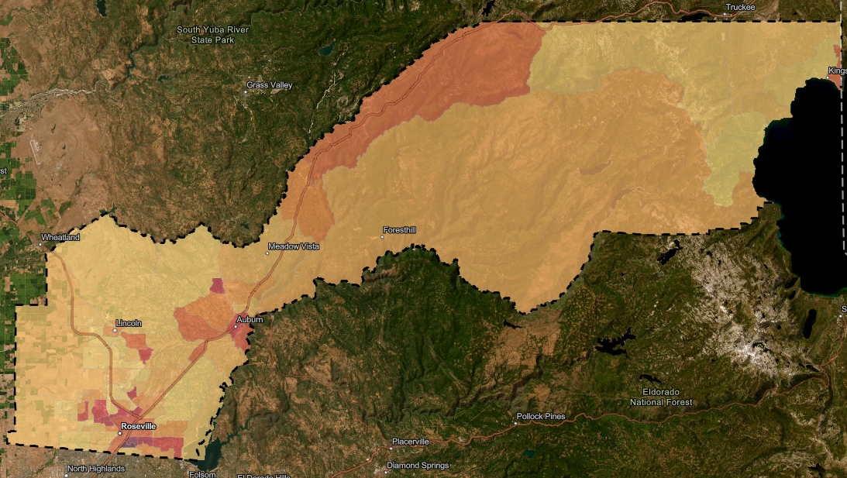
Decreased ownership of personal vehicle
Notes:
It is important to ensure that individuals without reliable personal transportation can conveniently access a nearby location. The regions with lower personal vehicle ownership rates are emphasized with darker colors.

Slide 15
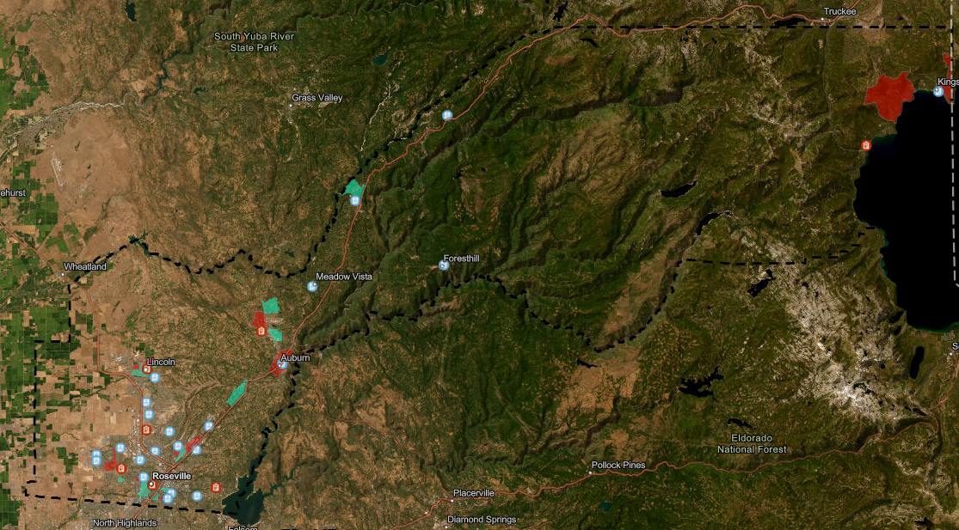
Low-income and disadvantaged communities
Notes:
Similar to vehicle ownership, proposed locations take higher rates of low-income (teal) and disadvantaged (red) communities into consideration.

Slide 16
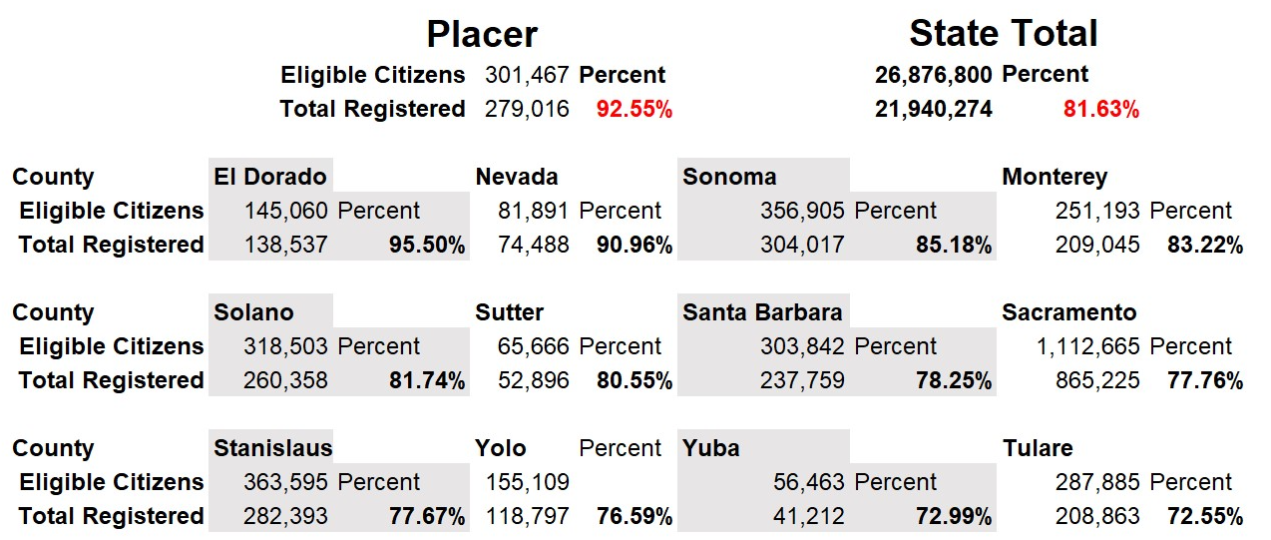
Notes:
Vote Centers provide opportunities for voters who are not registered to vote, to register and vote in person.
Placer County has the second-highest registration rate in the State and is more than 10% higher than the State average.

Slide 17
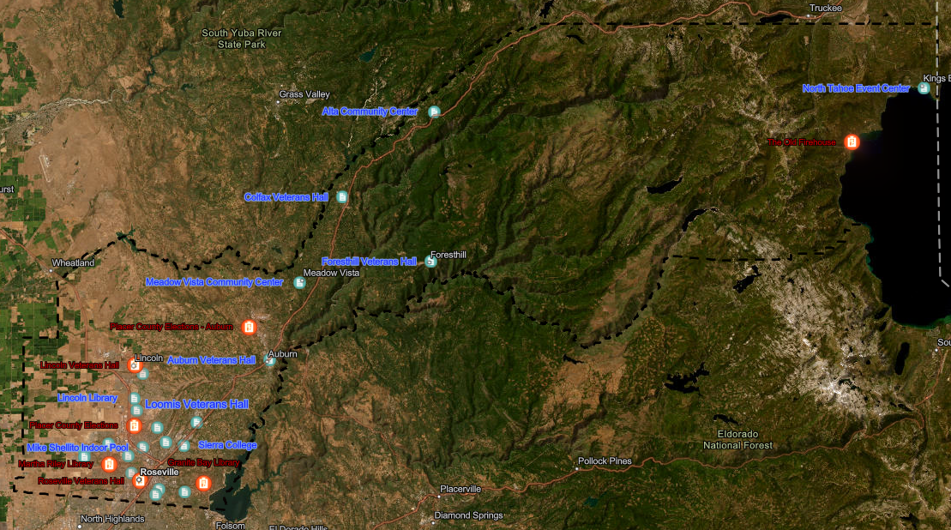
Geographically-isolated areas
Notes:
Geographically isolated communities are a factor in determining locations.
In Placer County, the communities east of Auburn along the Interstate 80 corridor, and the communities of Foresthill and North Lake Tahoe, are separated from the rest of the county, and each other.
Vote Centers are proposed in locations to best provide services for the majority of voters in those areas.

Slide 18
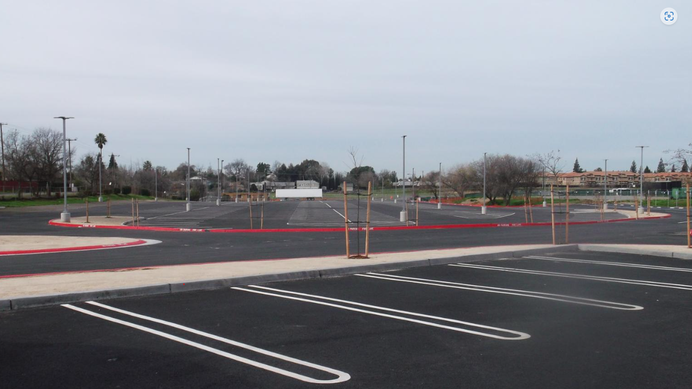
Parking areas are surveyed
Notes:
Each vote center parking area is surveyed by staff to ensure they are accessible, and any mitigations are brought to the Placer County Voting Accessibility Advisory Committee (VAAC) for input.

Slide 19
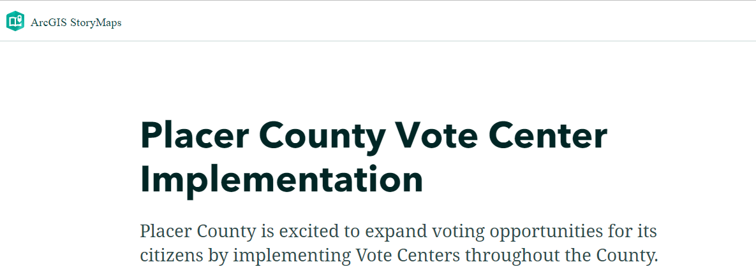
StoryMaps will be available on our website
Notes:
Soon you will have full access to the interactive web-based mapping program called StoryMaps. There you can zoom in and click on specific locations or areas within the county. StoryMaps will be up on our website soon at www.placercountyelections.gov on the VAAC page.

Slide 20
DISCUSSION ON MITIGATIONS
QUESTIONS AND ANSWERS

Slide 21
FUTURE ITEMS

Slide 22
Language Accessibility Advisory Committee (LAAC)
A forum where representatives of voters with diverse language needs have the opportunity to discuss and provide input on language accessibility issues.

Slide 23
Agenda
Elections Staff/Attendee Introductions
Committee Role
Presentations:
VCA/Draft Election Administration Plan (EAP)
Vote center handout – required languages/locations
Language minorities defined - map
Equal accessibility
Questions/Comments
Future Agenda Items

Slide 24
Election Administration Plan
Voters Choice Act
Draft Plan
Vote Centers
Drop Boxes
Public Input
Voter Contact(s)
Language Minority Communities
Voters with Disabilities

Slide 25
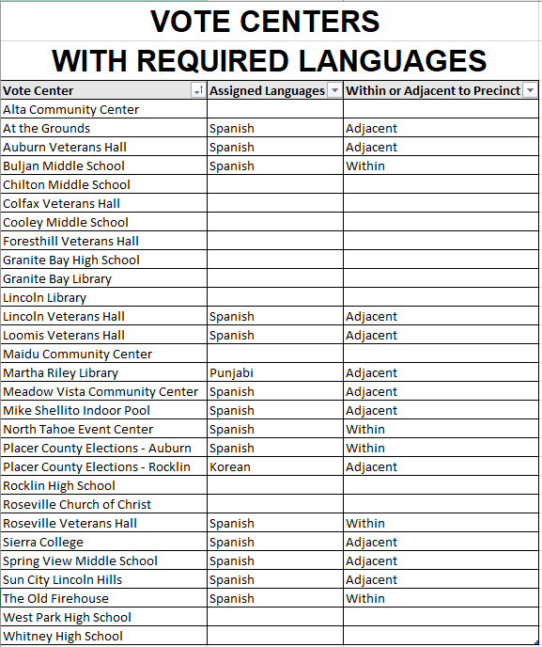
Vote Center Locations
Notes:
A lavender handout of the proposed vote centers was handed out at the start of the meeting and includes the required language or languages in specific locations for Placer County. The county is required by state and federal law to offer certain services and materials in additional languages at vote centers located in or adjacent to communities, including providing translators based on specific criteria.

Slide 26
Language minority communities
Notes:
Language minority communities is an important consideration when deciding on the locations of vote centers.
In Placer County, there are four additional languages besides English, with Spanish being the only one prevalent across most of the county, marked in red on the map.
Korean (purple), Punjabi (blue), and Tagalog (yellow) are used in some communities in southwest Placer. Orange indicates areas where Spanish and Tagalog are spoken together.

Slide 27
Equal Accessibility
Placer County language accessibility accommodations include:
Facsimile ballots
State (VIG) voter information guides
County (VIG) voter information guide pages
Signage
Bilingual election officers
Translation line
Notes:
Placer County language accessibility accommodations for voters whose primary language is other than English, in specific locations will include:
Translated facsimile ballots
Translated state voter information guides
Specific signage identified by the Elections Code and state regulations
Election Officer translators are easily identified with badges

Slide 28
QUESTIONS AND COMMENTS

Slide 29
FUTURE ITEMS

Slide 30
THANK YOU!

