Slide 1
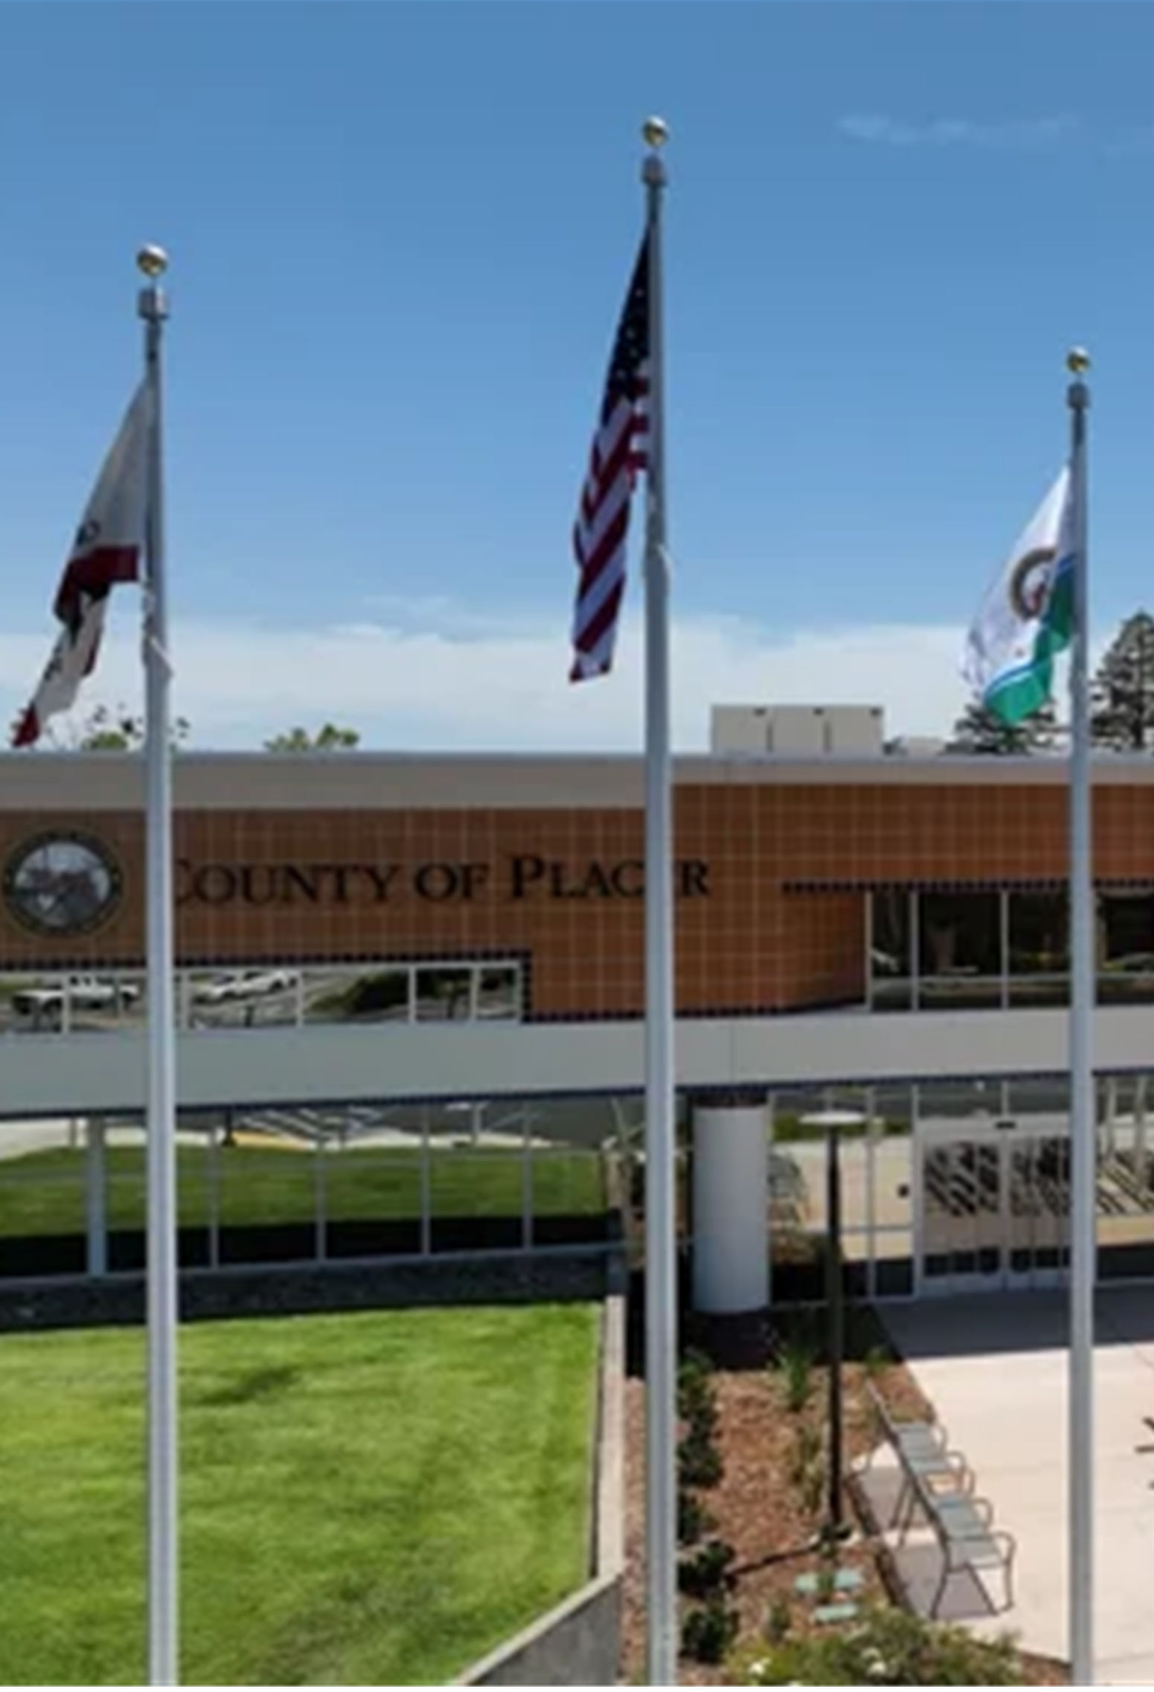
Consultation Meeting
Placer County
Language Communities
A forum for interested residents, representatives, advocates and individuals from Placer County’s Language Communities to provide consultation and public input on the revision of the County’s Election Administration Plan

Slide 2
Agenda
Elections Staff/Attendee Introductions
Presentations:
  VCA/drafted Election Administration Plan (EAP)
  StoryMap presentation on factors considered
  placercountyelections.gov/voters-choice-act
  Equal Accessibility
    Dropbox accessibility
  Discussion on Feedback / Input
  Questions & Answers
  Calendar
Notes:
Introductions
Role of a committee member (input) and time commitment (yearly) – meeting quarterly / twice a year ?

Slide 3
Election Administration
Plan
Voter’s Choice Act
Drafted Plan
    Vote Centers
    Drop Boxes
    Public Input
    Voter Contact(s)
    Language Minority Communities
    Voters with Disabilities

Slide 4
Vote Center
Locations
11-day locations
Placer County Clerk-Recorder Office, Auburn
Placer County Elections Office, Rocklin
Lincoln Veterans Hall
Martha Riley Library, Roseville
Roseville Veterans Hall
Granite Bay Library
The Old Firehouse, Tahoe City
Notes:
A handout of the proposed vote centers and a list of drop boxes were handed out at the start of the meeting for your review. They will be accessible via the Placer County Elections website (www.placercountyelections.gov) as soon as they are completed.

Slide 5
Vote Center
Locations
4-day locations
SPFPD Station 19
Sheridan Stewart Hall
Colfax Veterans Hall
Foresthill Veterans Hall
Meadow Vista Community Center
Auburn Veterans Hall
Loomis Veterans Hall
Lincoln Library
Sun City Lincoln Hills
Whitney High School
Sierra College
Cooley Middle School
Victory High School
St. John’s Episcopal Church
Mike Shelito Indoor Pool
Chilton Middle School
Maidu Community Center
RJUHSD District Office
@the Grounds
Granite Bay High School
Buljan Middle School
Springview Middle School
Notes:
A handout of the proposed vote centers and a list of drop boxes were handed out at the start of the meeting for your review. They will be accessible via the Placer County Elections website (www.placercountyelections.gov) as soon as they are completed.

Slide 6
Drop Box
Locations
Placer County Elections Office – Rocklin
Rocklin Library
Rocklin City Clerk’s Office
Sierra College
Destiny Community Center, Rocklin
Whitney Ranch, Rocklin
Veterans Services Office, Rocklin
Sun City Lincoln
Lincoln City Clerk’s Office
Granite Bay Library
Loomis Town Clerk’s Office
Nugget Market (Pleasant Grove)
Santucci Justice Center, Roseville
Nugget Market (Blue Oaks)
Oriental Market
Martha Riley Library, Roseville
Roseville City Clerk’s Office
Roseville Downtown Library
Maidu Library, Roseville
Foresthill Veterans Hall
Colfax City Clerks’ Office
Colfax Library
Kings Beach Library
The Old Firehouse, Tahoe City
Auburn City Clerk’s Office
Olympic Valley Public Service
Placer County Clerk-Recorder Office, Auburn
Truckee Tahoe Airport
Gurdwara Sahib Sikh Temple
Notes:
A handout of the proposed vote centers and a list of drop boxes were handed out at the start of the meeting for your review. They will be accessible via the Placer County Elections website (www.placercountyelections.gov) as soon as they are completed.

Slide 7
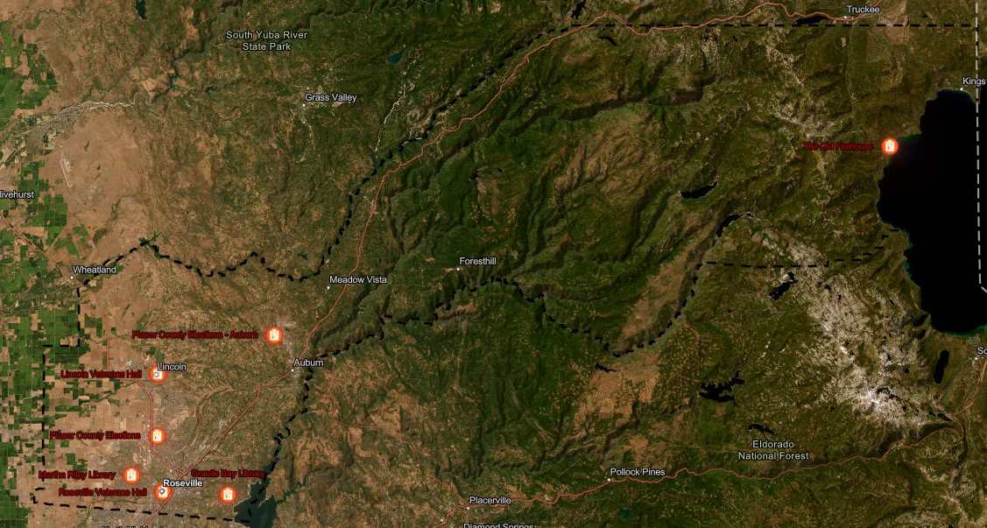
11-Day Vote Centers
Notes:
11-Day Vote Centers: ​
​
Starting on the Saturday two weekends before the election, 11-day vote centers will become available throughout Placer County. These centers give the public the opportunity to register to vote, obtain a replacement ballot, submit their voted ballot or vote in person.

Slide 8
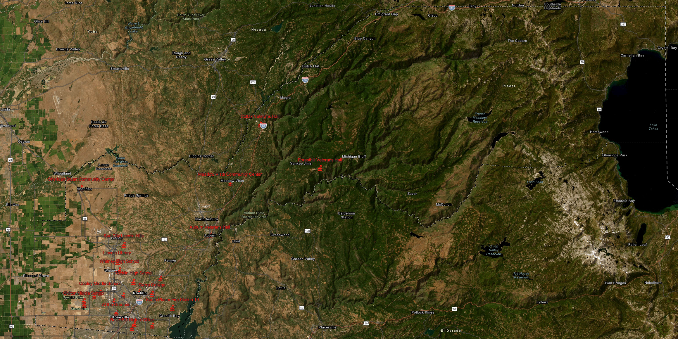
11-day vote centers
4-Day Vote Centers
Notes:
4-Day Vote Centers:​
​
On the Saturday four days prior to the election, more locations will be included across the county to offer convenient options to voters and citizens as demand increases.

Slide 9
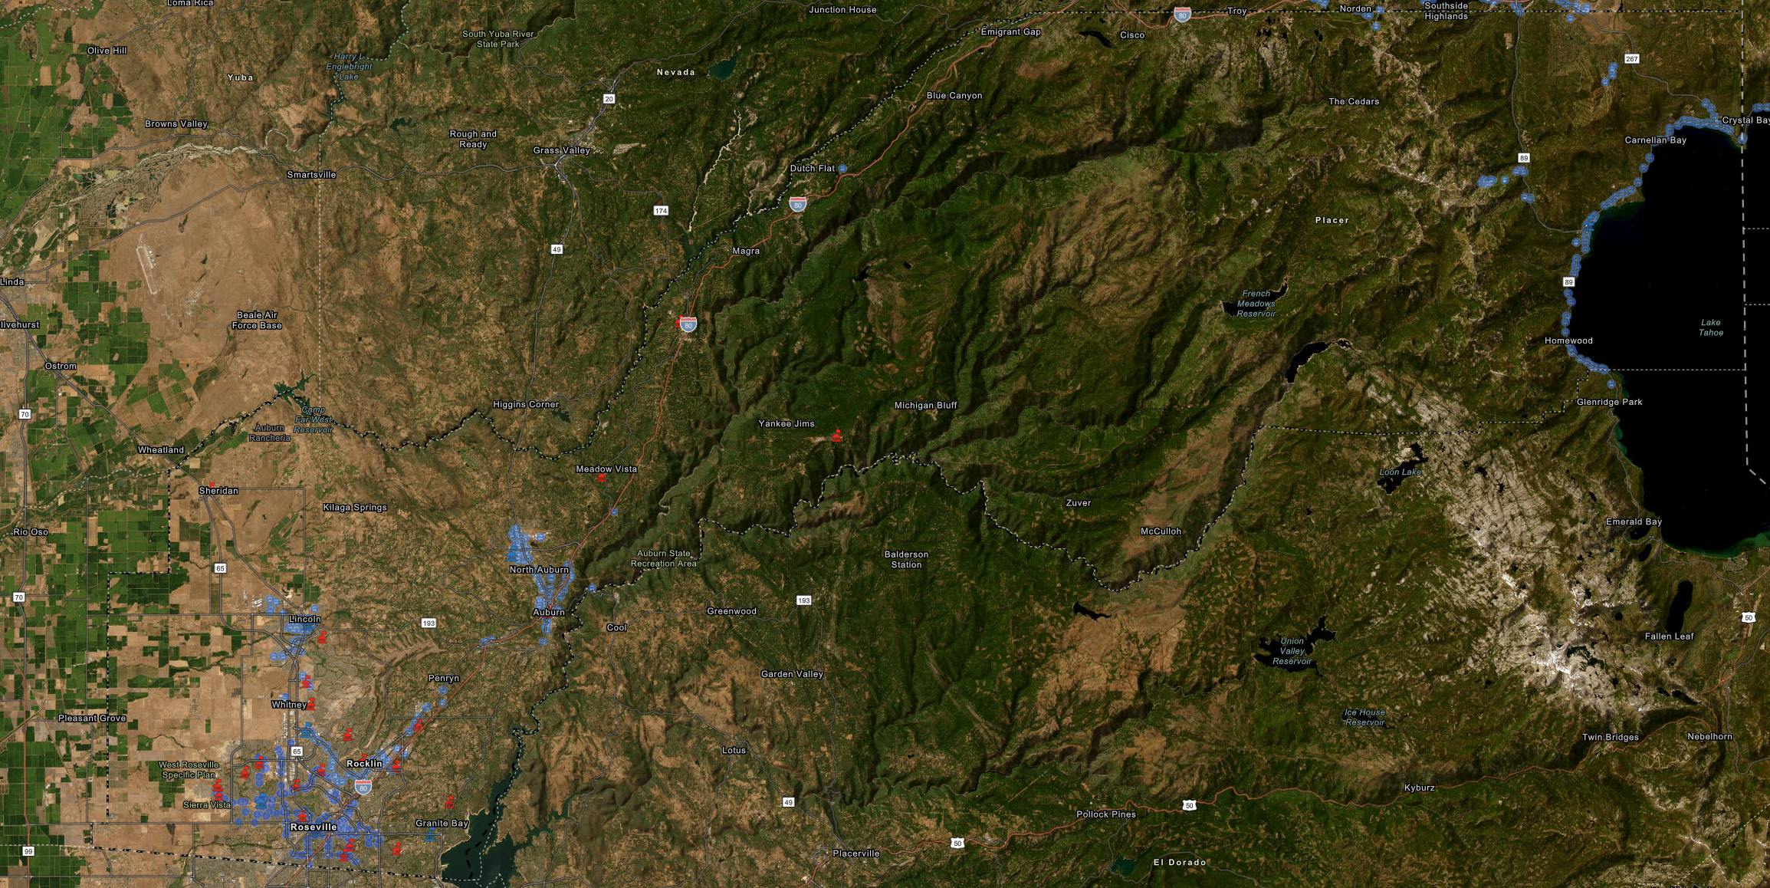
Public Transit
Notes:
To allow transit riders the shortest walk to a vote center location, the site should be as close to public transit as possible.
The majority of the proposed vote center locations are within 200 feet of a designated bus stop.

Slide 10
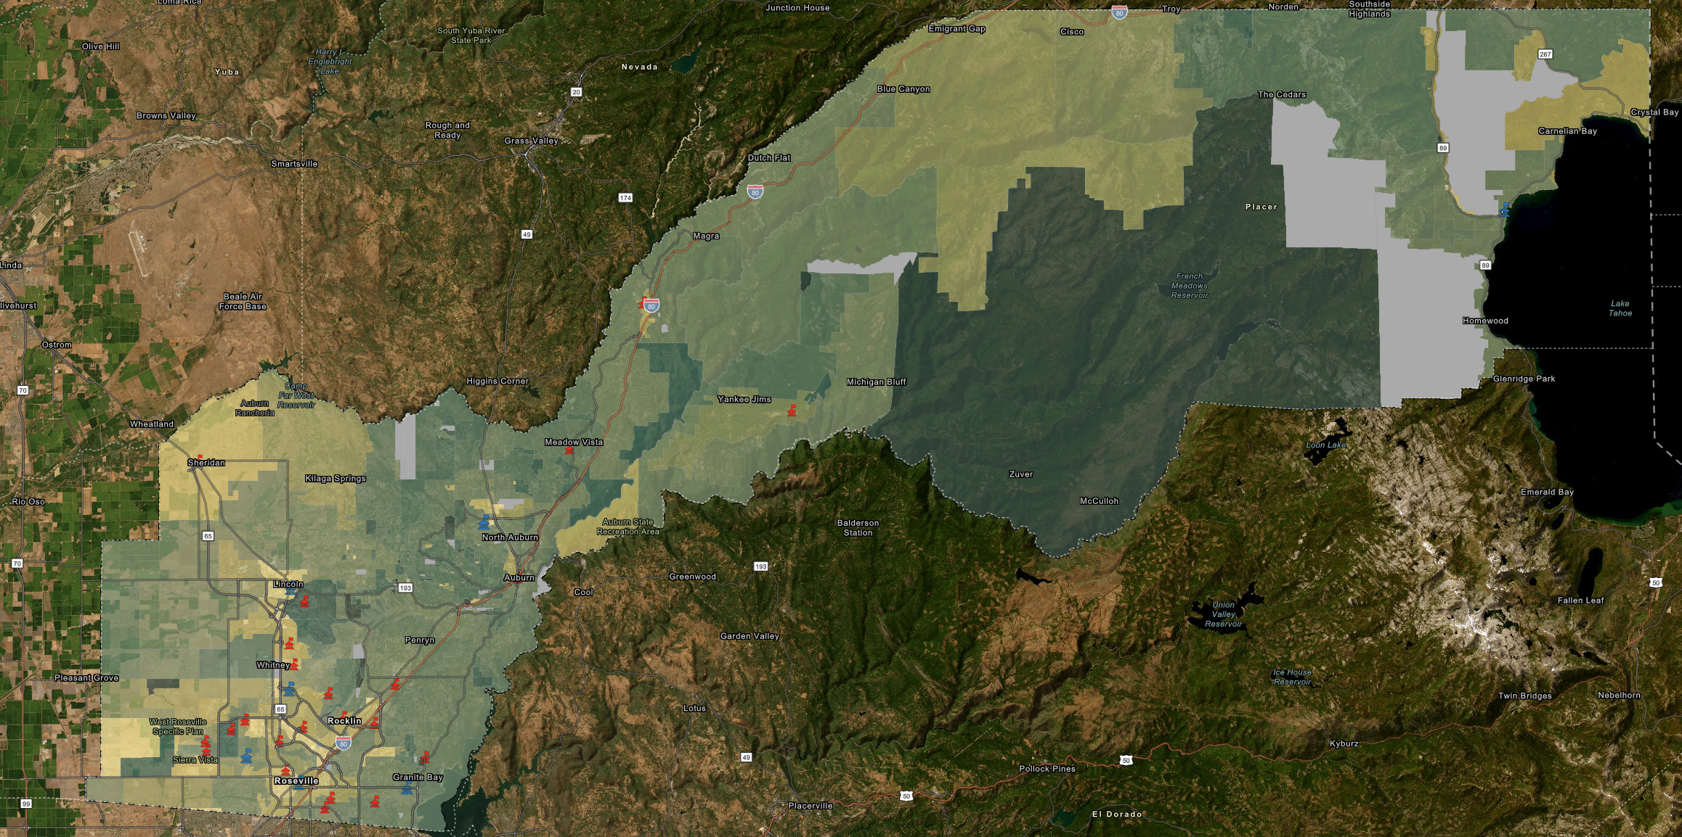
Low Mail Ballot Utilization
Notes:
When determining vote center locations, priority should be given to areas with low mail ballot utilization, specifically those with darker colors shown in the map above.
Mail ballot utilization refers to the percentage of eligible voters who had the option to vote by mail but chose not to. Locations with lower percentages of mail ballot utilization may indicate that voters prefer to vote in person.

Slide 11
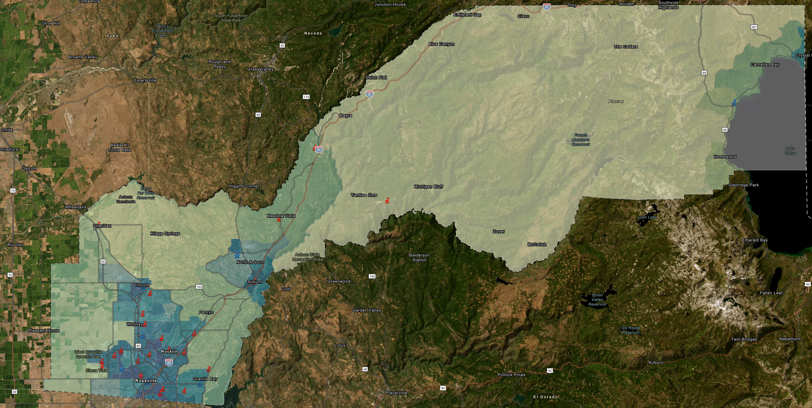
High-Density Population
Notes:
To maximize accessibility, vote centers should be placed in, or near, densely populated areas (marked by darker colors on the map above).
Strategic placement ensures that the largest number of citizens and voters will have easy access to voting with minimal travel time required.

Slide 12
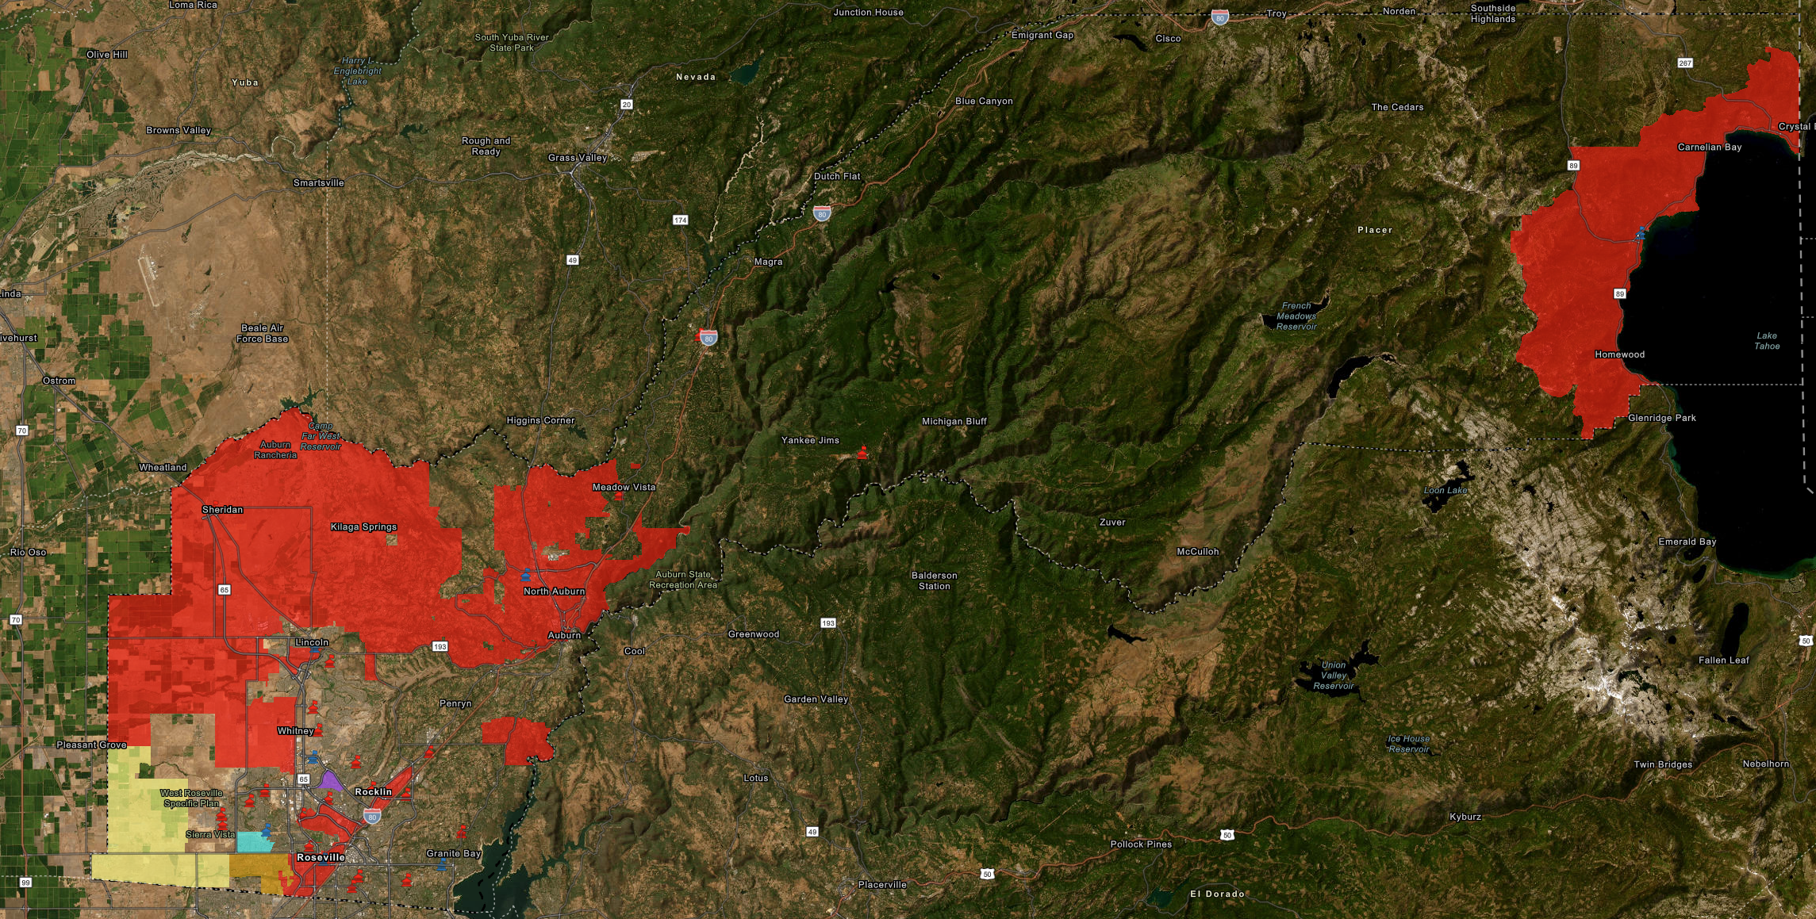
Language Minority Communities
Notes:
Language minority communities are an important consideration when deciding the locations of vote centers.
In Placer County, there are four additional languages besides English, with Spanish being the only one prevalent across most of the county (marked in red on the map).
Korean (purple), Punjabi (blue), and Tagalog (yellow) are present in some communities in southwest Placer. Orange indicates areas where Spanish and Tagalog are spoken together.
Placer County is required by state and federal law to offer certain services and materials in these additional languages at vote centers located in or adjacent to these communities, including providing translators.

Slide 13
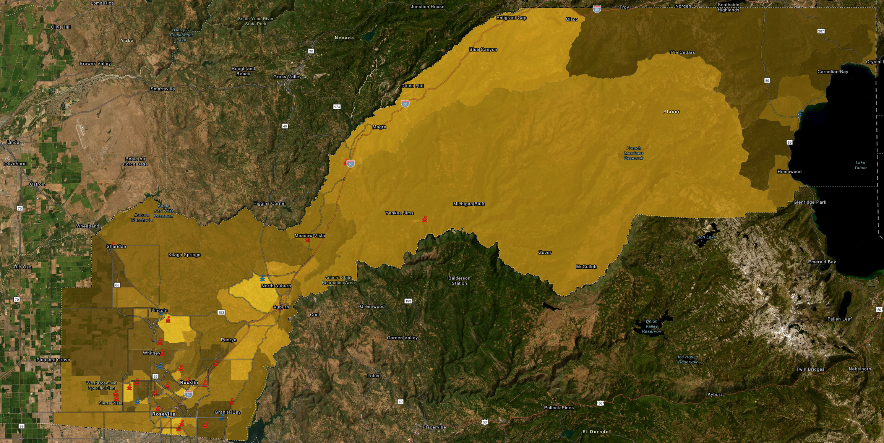
Higher Rates of Disabilities
Higher Rates of Disabilities
Notes:
Vote centers are designed to assist voters with disabilities. By placing them near communities with higher rates of disabled residents (highlighted in bright yellow), these voters can easily access the services offered.

Slide 14
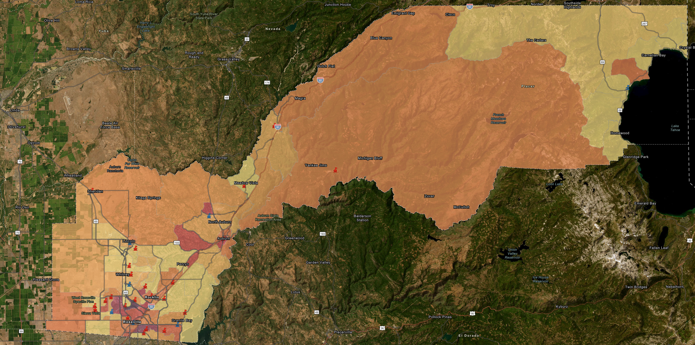
Decreased Ownership of Personal Vehicles
Notes:
It is important to ensure that individuals without reliable personal transportation can conveniently access a nearby location. The regions with lower personal vehicle ownership rates are emphasized with darker colors in the map above.

Slide 15
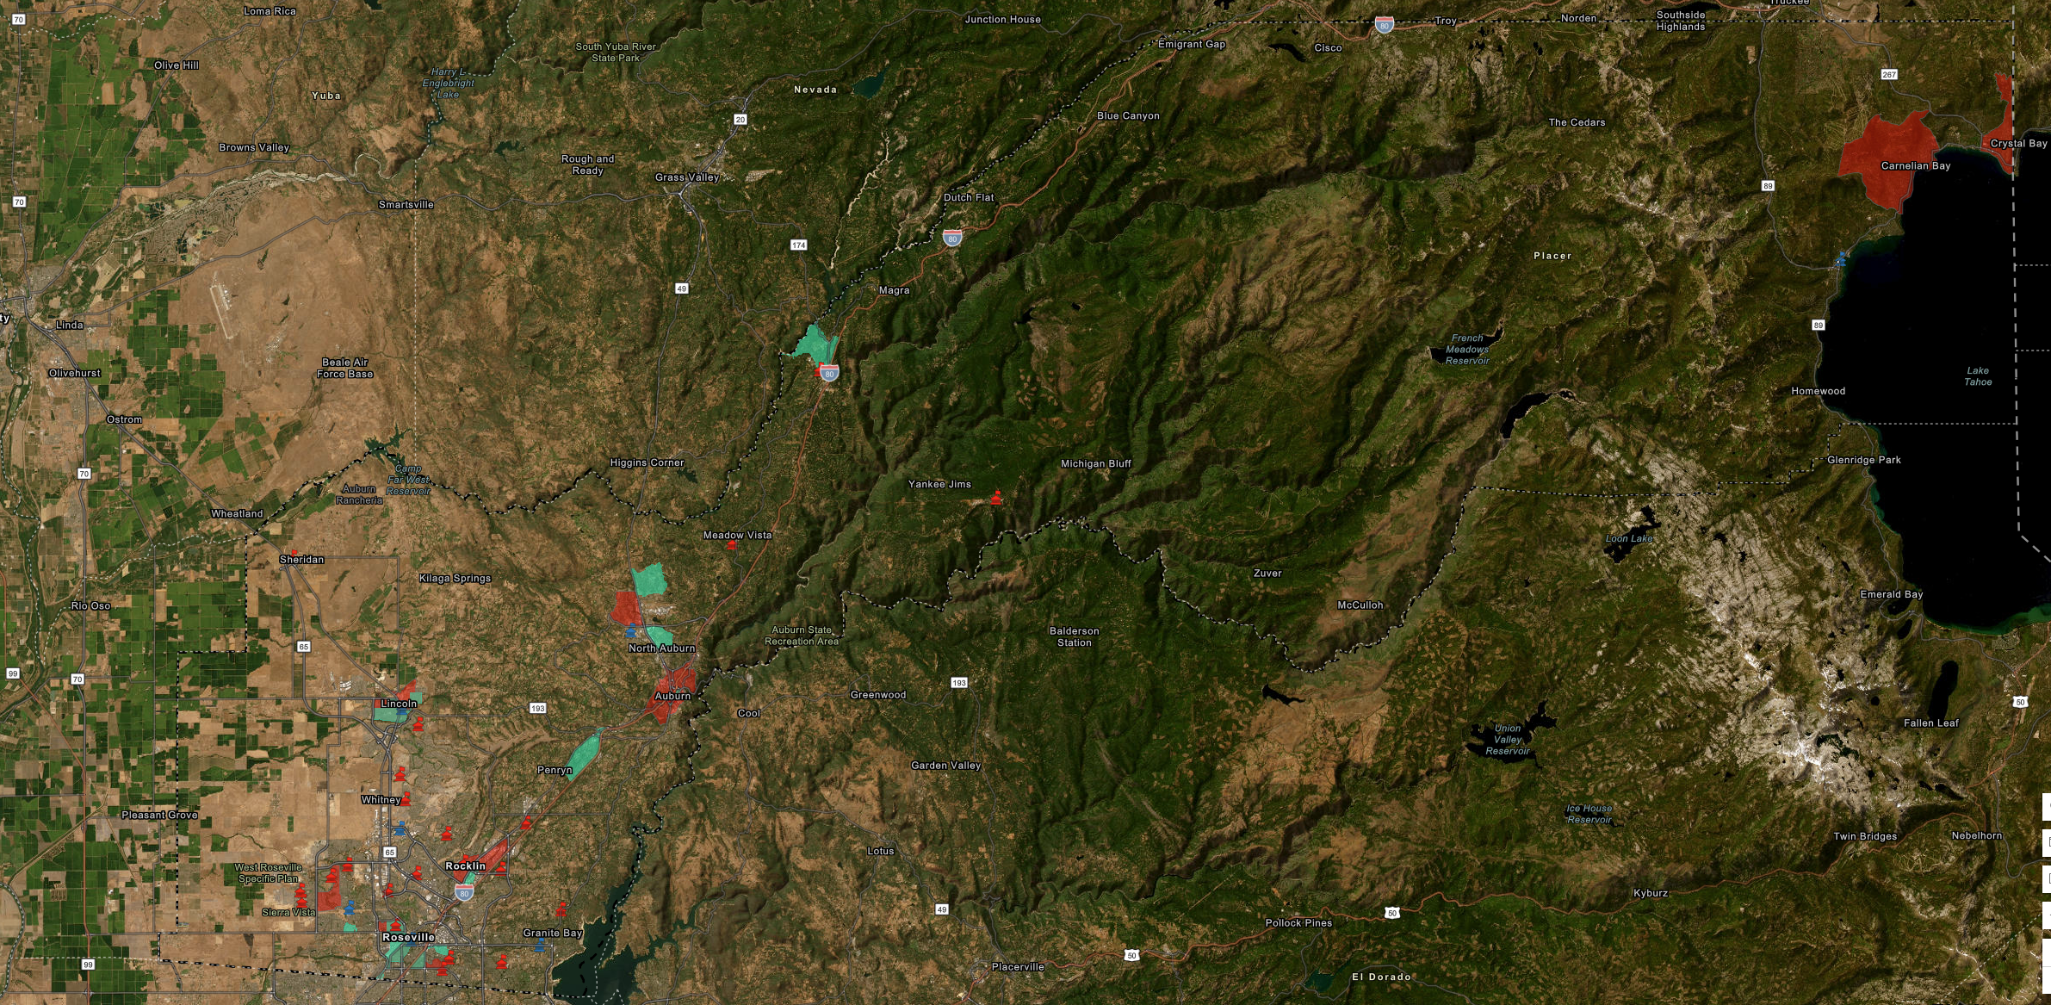
Low-Income and Disadvantaged Communities
Notes:
Similar to low rates of personal vehicle ownership, proposed locations also take higher rates of low-income (teal) and disadvantaged (red) communities into consideration.

Slide 16
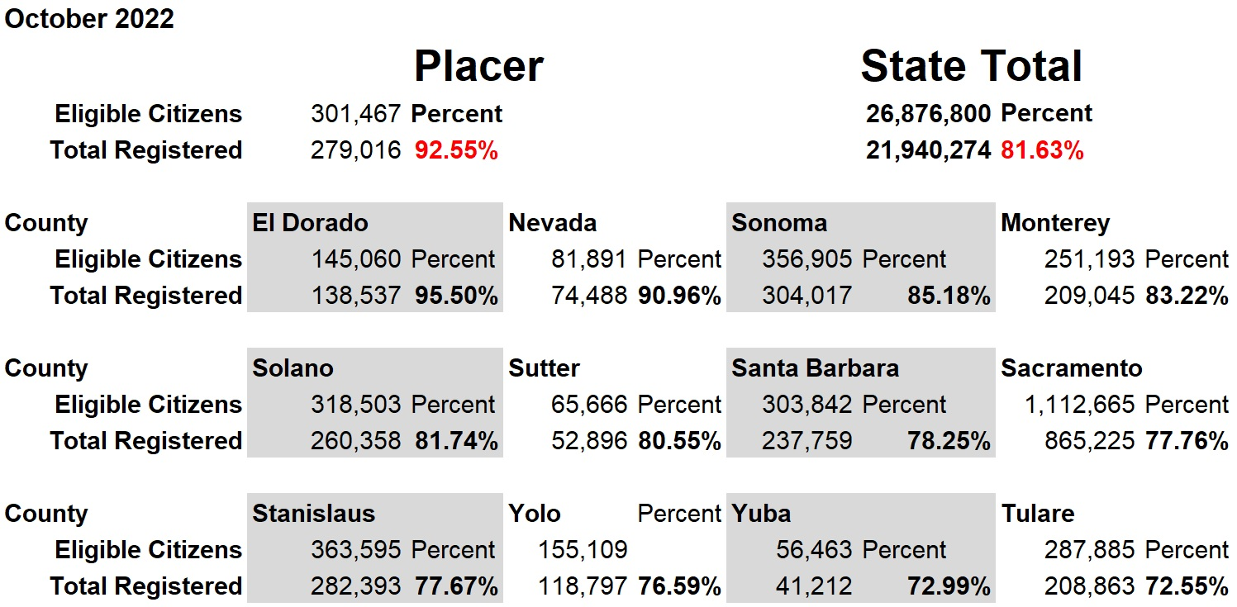

Slide 17
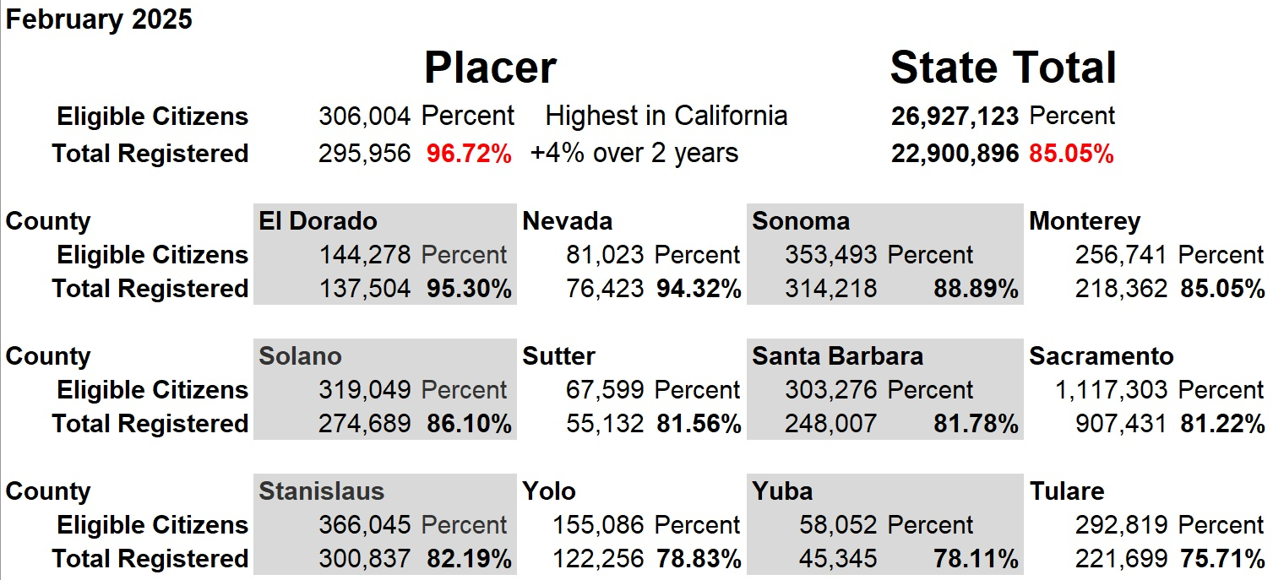
Notes:
Vote centers provide opportunities for voters who are not registered to vote to register and vote in person.
Placer County has the second-highest registration rate in the State of California, a rate that is more than 10% higher than the State average.

Slide 18
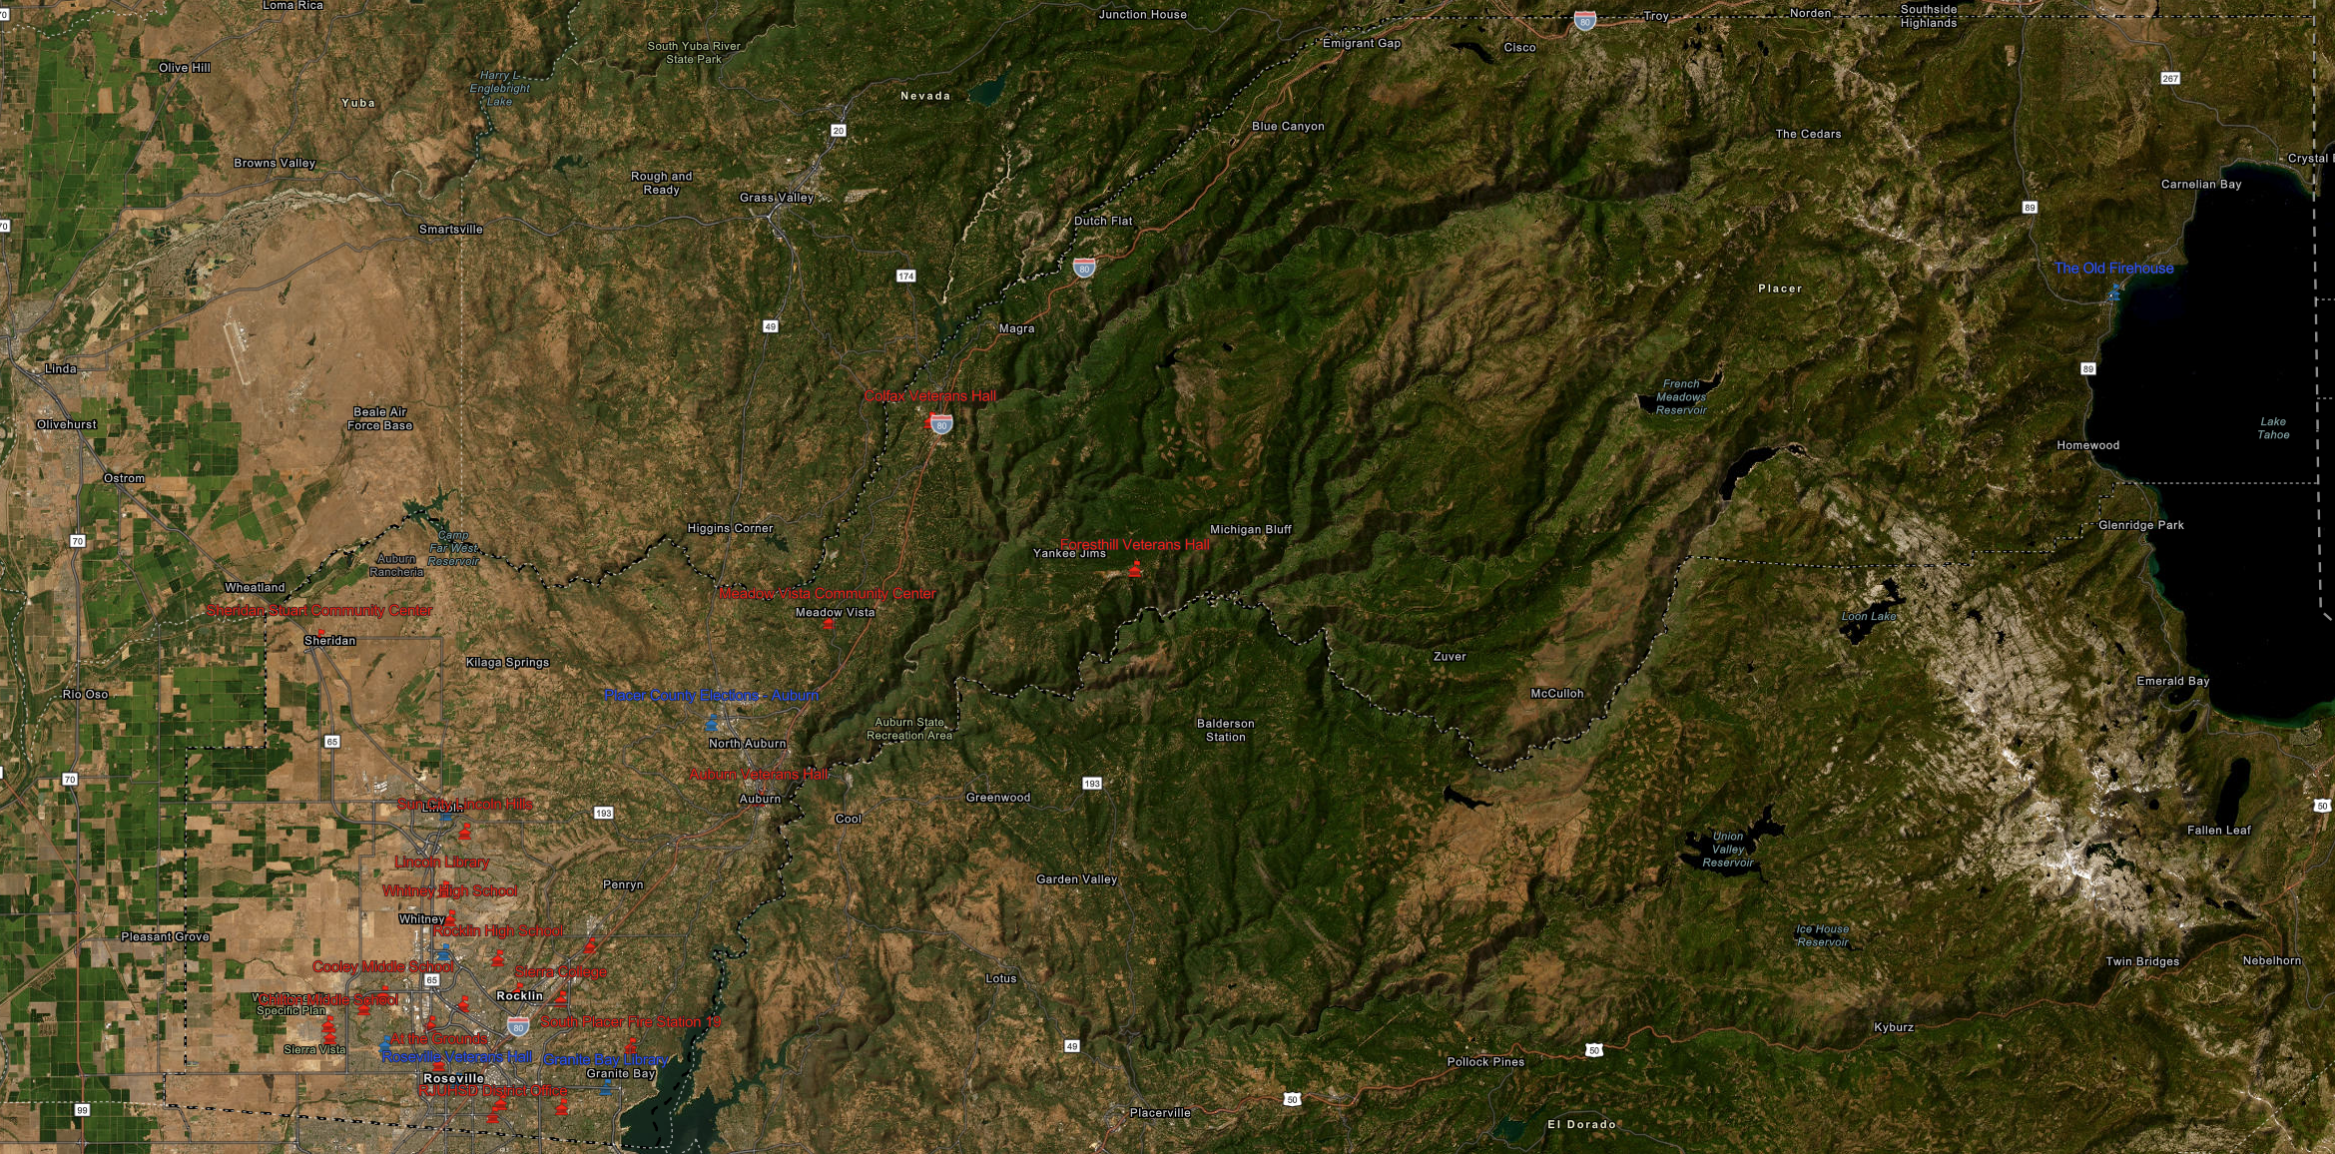
Geographically-Isolated Areas
Notes:
Geographically-isolated communities are a factor in determining locations.
In Placer County, the communities east of Auburn along the Interstate 80 corridor, and the communities of Foresthill and North Lake Tahoe, are separated from the rest of the county and each other.
Vote centers are proposed in locations that will best provide services for the majority of voters in those areas.

Slide 19
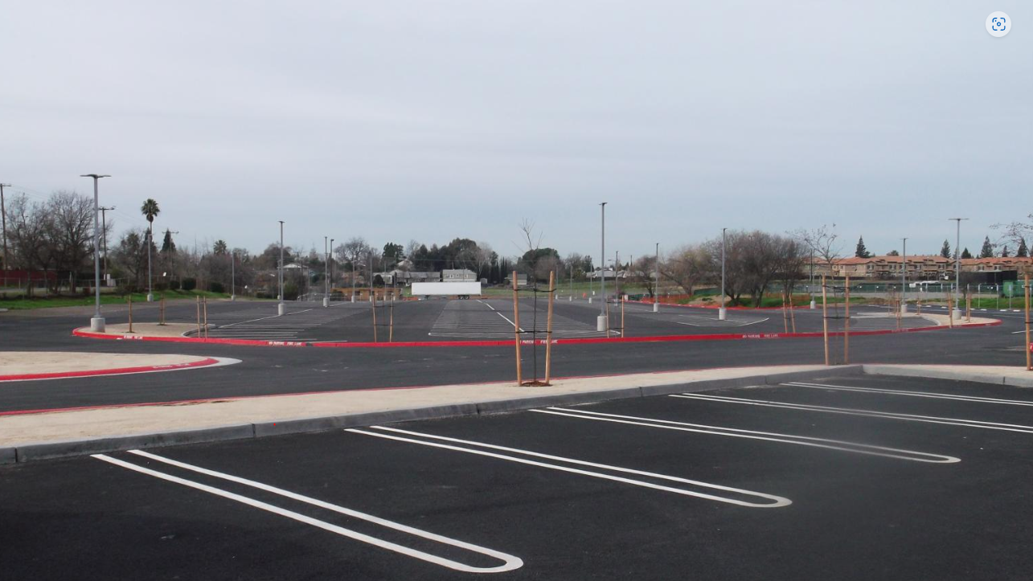
Parking Areas are Surveyed
Notes:
Each vote center parking area is surveyed by staff to ensure they are accessible, and any mitigations are brought to the Placer County Voting Accessibility Advisory Committee (VAAC) for input.

Slide 20
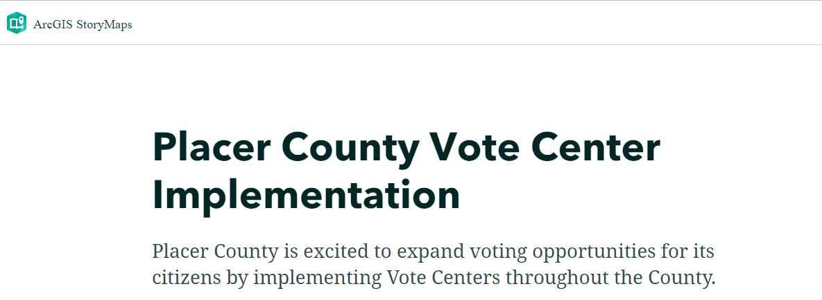
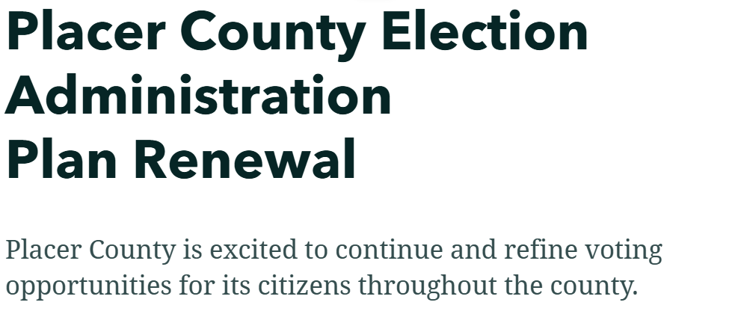
StoryMaps is available on our website
Notes:
You will soon have full access to the interactive web-based mapping program called StoryMaps. There you can zoom in and click on specific locations or areas within the county.
StoryMaps will soon be up on our website at www.placercountyelections.gov on the VAAC page (www.placercountyelections.gov/advisory-committee/).

Slide 21
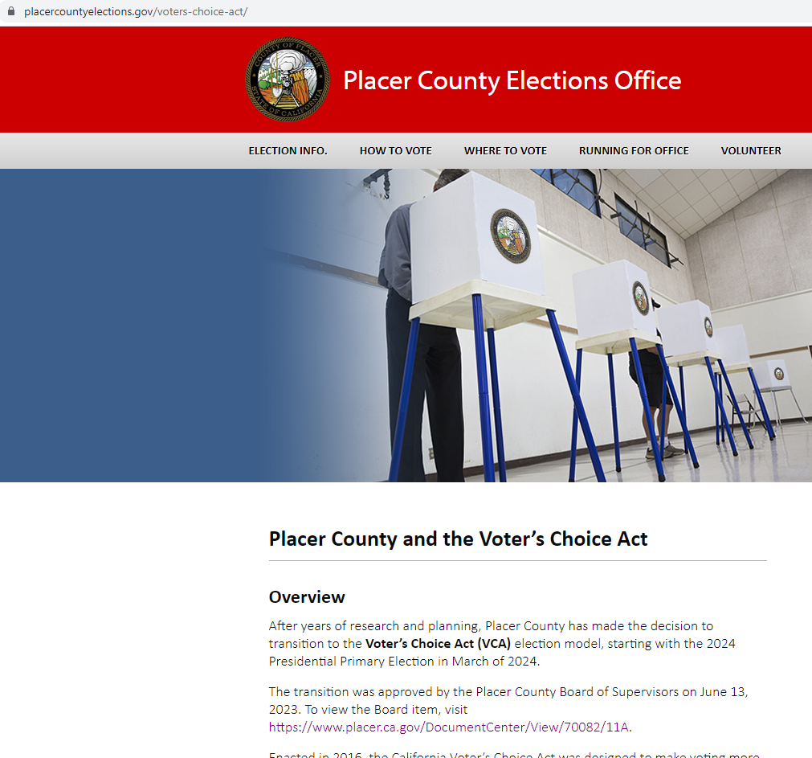
Placer Elections website
placercountyelections.gov
Notes:
A handout of the proposed vote centers and a list of drop boxes were handed out at the start of the meeting for your review. A list of these locations will be available on the Placer County Elections website (www.placercountyelections.gov) as soon as they are complete.

Slide 22
Equal Accessibility
Placer County accessibility accommodations include:
RAVBM
County (VIG) voter information guide pages
Signage
Election officer training
Curbside voting
Accessible ballot-marking devices
Vote center canvassing and surveys
Accessible ballot drop-boxes
Notes:
Placer County language accessibility accommodations for voters whose primary language is other than English, in specific locations will include:
Translated facsimile ballots
Translated state voter information guides
Specific signage identified by the California Elections Code and state regulations
Election officer translators are easily identified with badges

Slide 23
Introduction to Ballot Drop Box Accessibility
Vote-by-Mail (VBM) Unit
Introduction to Ballot Drop Box Accessibility
Vote-by-Mail (VBM) Unit

Slide 24
Drop Box Design
There are 31 drop boxes total.
Models 710, 810 and 910 are built by American Security Cabinets. (americansecuritycabinets.com)
From the manufacturer’s website:
  “Our ballot drop boxes are ADA Title I and II Compliant, offering one-hand delivery at ADA height.”
These drop boxes require less than 2 lbs. of pressure to open the ballot slot.
The ballot slot spans 47 to 48 inches from the ground.
There are 31 drop boxes total.
Models 710, 810 and 910 are built by American Security Cabinets. (americansecuritycabinets.com)
From the manufacturer’s website:
  “Our ballot drop boxes are ADA Title I and II Compliant, offering one-hand delivery at ADA height.”
These drop boxes require less than 2 lbs. of pressure to open the ballot slot.
The ballot slot spans 47 to 48 inches from the ground.
Drop Box Design

Slide 25
California Code of Regulations
20132. Drop Box Design and Requirements:
  (g) Drop boxes shall be designed to function as follows:
    (1) Drop box hardware shall be operable without any tight grasping, pinching, or twisting of the wrist.
    (2) Drop box hardware shall require no more than 5 lbs. of pressure for the voter to operate.
    (3) Accessible drop boxes shall be operable within reach-range of 15 to 48 inches from the finish floor or ground for a person utilizing a wheelchair. This shall not apply to a drop box meant to be used by drivers of vehicles.
    (4) Signage for ballot drop boxes shall be in a distinct color type that contrasts with the background and have a no-glare finish.
20132. Drop Box Design and Requirements:
  (g) Drop boxes shall be designed to function as follows:
    (1) Drop box hardware shall be operable without any tight grasping, pinching, or twisting of the wrist.
    (2) Drop box hardware shall require no more than 5 lbs. of pressure for the voter to operate.
    (3) Accessible drop boxes shall be operable within reach-range of 15 to 48 inches from the finish floor or ground for a person utilizing a wheelchair. This shall not apply to a drop box meant to be used by drivers of vehicles.
    (4) Signage for ballot drop boxes shall be in a distinct color type that contrasts with the background and have a no-glare finish.
California Code of Regulations

Slide 26
Drop Box Indoor Site Surveys
We survey new indoor drop box locations using the Secretary of State’s Polling Place Accessibility Guidelines. (https://www.sos.ca.gov/elections/publications-and-resources/polling-place-accessibility-guidelines)
For drop boxes, there is no Voting Area diagram.
We survey new indoor drop box locations using the Secretary of State’s Polling Place Accessibility Guidelines. (https://www.sos.ca.gov/elections/publications-and-resources/polling-place-accessibility-guidelines)
For drop boxes, there is no Voting Area diagram.
Drop Box Indoor Site Surveys

Slide 27
Drop Box Outdoor Site Surveys
Outdoor surveys focus on the parking lot, route of travel, curb ramps, ramps, public transportation and drop-off zones.
There is no check of the nearby building’s restrooms, doorways, hallways, entrances, elevators, etc.
Outdoor surveys focus on the parking lot, route of travel, curb ramps, ramps, public transportation and drop-off zones.
There is no check of the nearby building’s restrooms, doorways, hallways, entrances, elevators, etc.
Drop Box Outdoor Site Surveys

Slide 28
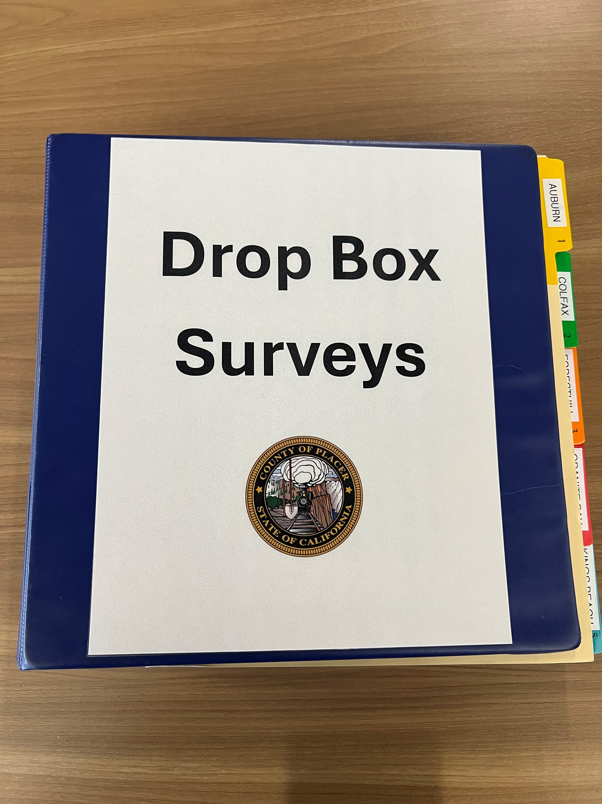
Survey Binder
Surveys and photos are stored digitally and printed in a binder for public viewing.
Surveys and photos are stored digitally and printed in a binder for public viewing.
Survey Binder

Slide 29
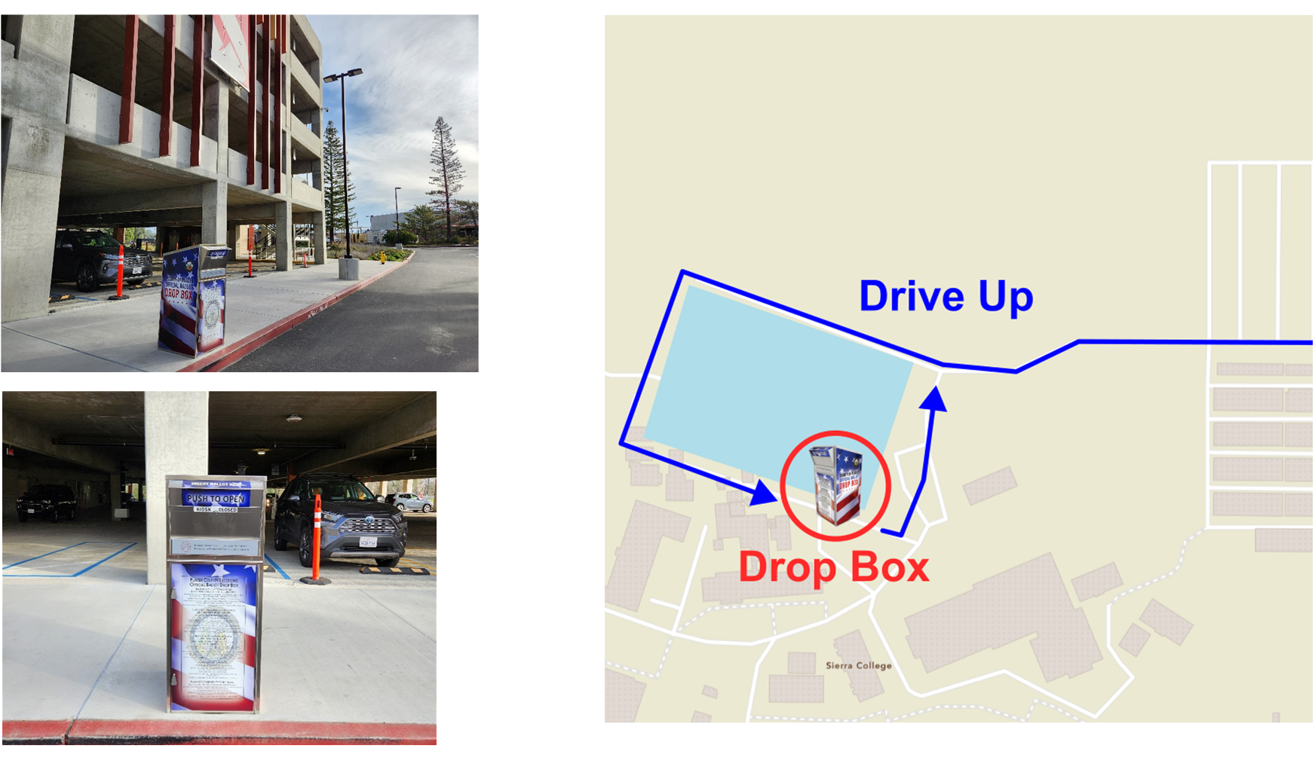
Drive-up Drop Boxes
4 locations are drive-up drop boxes.
Positioned on one-way roads.
4 locations are drive-up drop boxes.
Positioned on one-way roads.
Drive-up Drop Boxes

Slide 30
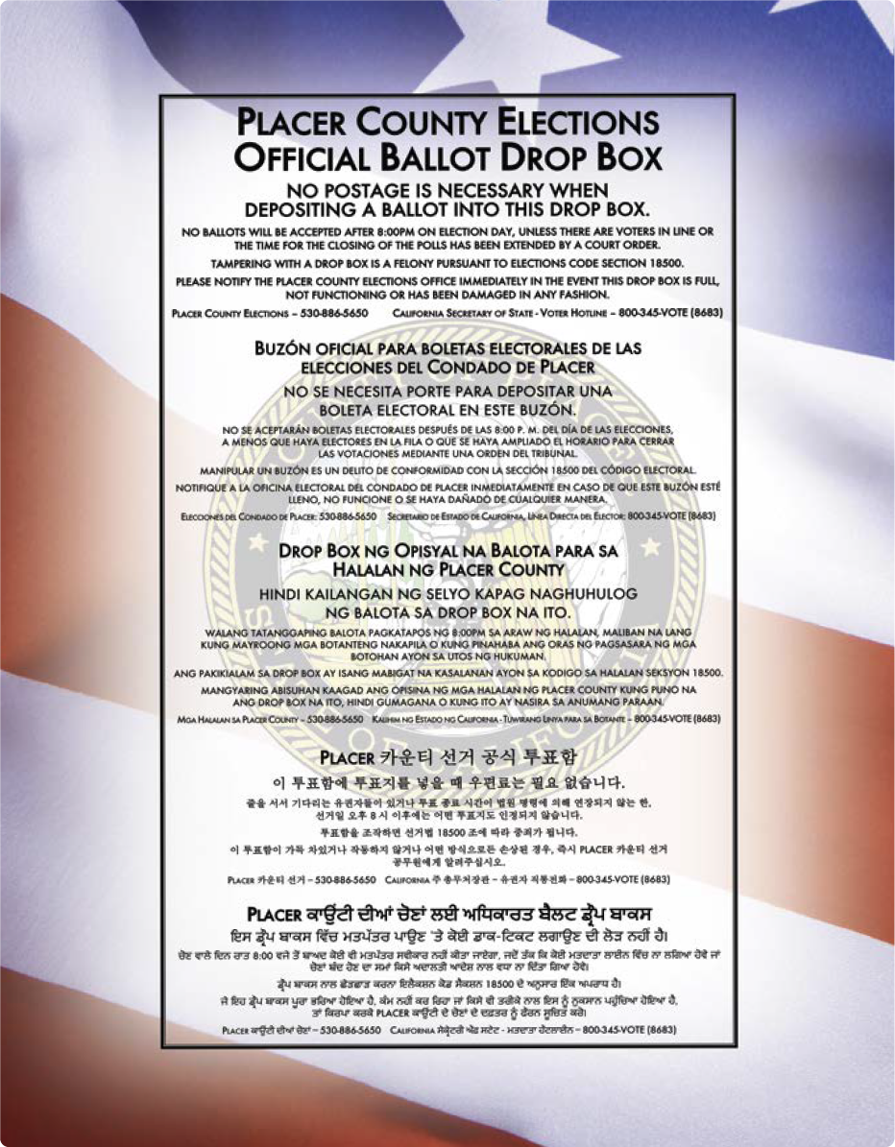
Language Accessibility
Drop boxes display important information in Placer County's 5 supported languages: English, Spanish, Tagalog, Korean and Punjabi.
  Front includes Placer
  County Elections phone
  number and SOS voter
  hotline.
  Sides explain
  electioneering laws.
Drop boxes display important information in Placer County's 5 supported languages: English, Spanish, Tagalog, Korean and Punjabi.
  Front includes Placer
  County Elections phone
  number and SOS voter
  hotline.
  Sides explain
  electioneering laws.
Language Accessibility

Slide 31

Site Accessibility
Sierra College Parking Garage has extra signage to guide voters to it due to the large campus.
At least 12 locations are within 200 feet of a public transportation stop.
All of Placer County’s 31 ballot
drop box locations have been
surveyed and determined to be accessible.
Sierra College Parking Garage has extra signage to guide voters to it due to the large campus.
At least 12 locations are within 200 feet of a public transportation stop.
All of Placer County’s 31 ballot
drop box locations have been
surveyed and determined to be accessible.
Site Accessibility

Slide 32
QUESTIONS AND ANSWERS
FEEDBACK / INPUT

Slide 33
THANK YOU!

